Slide 1

Dosage Disparities: Medicaid Reimbursement Trends and Predictive Insights
Raheela Charania
Prabhu Shankar
Rajivini Tiruveedhula
Notes:
Raheela - intro

Slide 2




Background and Motivation
Medicaid covers
1 in 5 Americans.
Significant
state-by-state differences exist in Medicaid drug reimbursements.
Reimbursement Insights Drive Better Allocation and Customer Transparency.
Exploring Medicaid reimbursement trends and identifying the key factors that influence them can lead to more efficient and equitable healthcare resource distribution.
2
Notes:
Raheela:
Medicaid is a major healthcare program in the US, providing coverage for a significant portion of the population. That’s why it’s so important to analyze this data.
Analyzing the factors that drive Medicaid drug reimbursement variations can help optimize resource allocation (where the money is needed for the population) and increase cost transparency in the healthcare system.
Explain unit
individuals and families with incomes below the Federal Poverty Level (FPL) are eligible

Slide 3
Business Problem / Research Question
Main Question
Secondary Question
Goals and Objectives
What factors drive Medicaid drug reimbursement variations across U.S. regions?
Can socioeconomic factors like GDP, poverty and weather conditions predict dosage disparities?
Explore state-level Medicaid reimbursement trends (2019–2024), build predictive models for units reimbursed and test if socioeconomic factors significantly explain variations.
3
Notes:
Raheela

Slide 4



Data Sources
Medicaid Drug Utilization Data |  | Massive Dataset |  | State-level Socioeconomic Data
2019-2024 data from the Centers for Medicare & Medicaid Services (CMS) |  | ~5 million records per year, requiring efficient data processing and handling |  | GDP, poverty and weather conditions from various government sources
The team leveraged a comprehensive set of Medicaid reimbursement data and socioeconomic indicators to explore the factors driving drug reimbursement disparities across the U.S.
4
Notes:
Raheela

Slide 5
Dataset Description
Identifiers & Keys
Product Name
Drug Details
Units of Drug Reimbursed (# of tablet, patches, vials, etc.)
# of Prescriptions Reimbursed
Manufacturer/ Distributor of Drug
Total Amount Reimbursed
Medicaid & Non-Medicaid Amount Reimbursed
Product Code
Package Size
NDC
Per Capita Personal Income
Utilization Type
Fee-For-Service Utilization
Date/Time Info
Year & Quarter of Dataset
Macro-Level State Indicators
Managed Care Organization Utilization
% of Population below Poverty Line
Average Annual Temperature per State
State-level Real GDP
Total State Population
5
Notes:
Rajivini
- Explain meaning of units reimbursed and that it’s the target variable.
- Explain # prescriptions

Slide 6




Data Cleaning
Data Filtering: FFSU vs. MCOU | Removed outliers | Variable Reduction | Numeric Standardization
75% of states enrolled in MCOU; trend continues upward. | Outliers were removed due to inconsistencies. | Product & labeler codes, package size dropped—already captured by NDC. | Numeric predictors were Min-Max scaled to ensure consistent ranges.
The data was thoroughly cleaned and prepared for further analysis, ensuring a robust foundation for the upcoming modeling and insights.
6
Notes:
Rajivini
75% of Medicaid beneficiaries are enrolled in MCOs and more states are switching to MCOs enrollements. Therefore, the Dataset was subseted to be more predictive of future plans. (https://www.medicaid.gov/medicaid/managed-care/downloads/2022-medicaid-managed-care-enrollment-report.pdf)

Slide 7
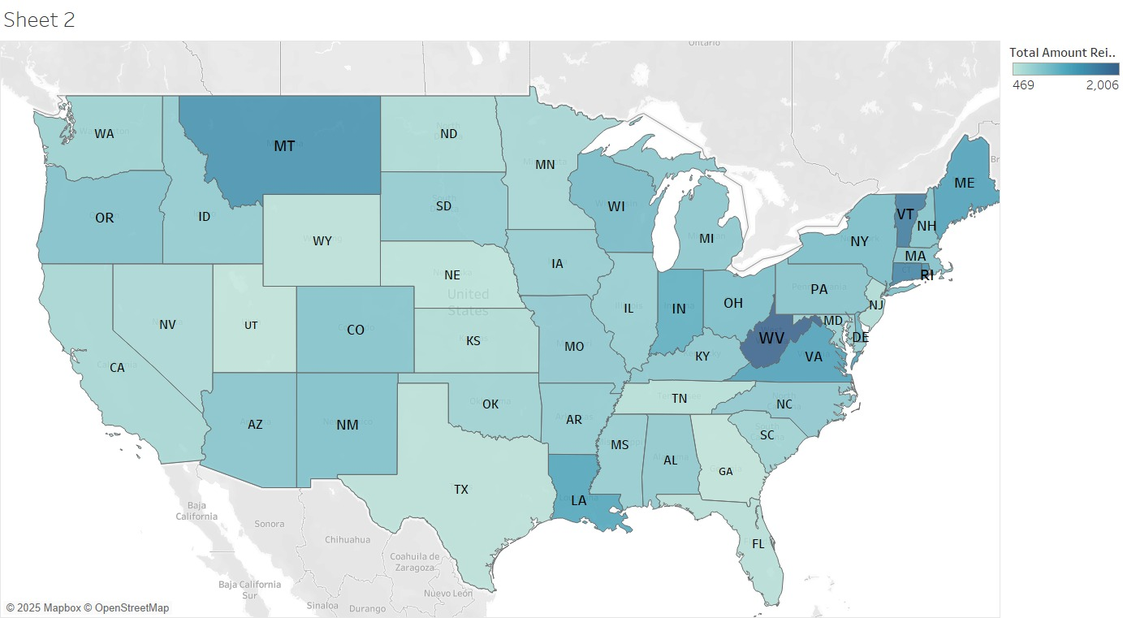
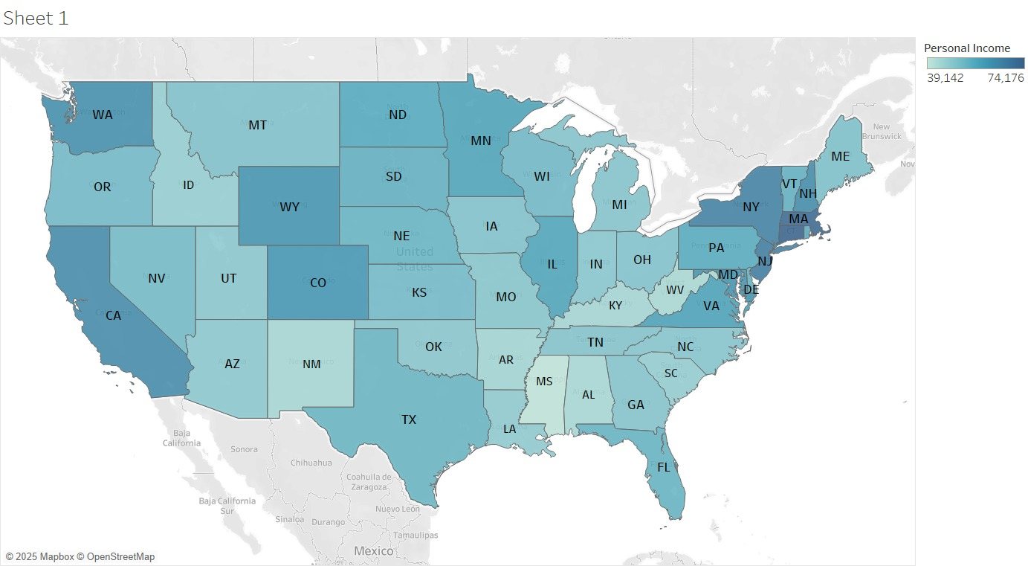
Exploratory Data Analysis
Total amount reimbursed per 100K individuals (2019)
Per Capita Personal Income (2019)
A negative correlation is observed between Per Capita Personal Income and the total amount reimbursed per 100K individuals.
7
Notes:
Rajivini

Slide 8
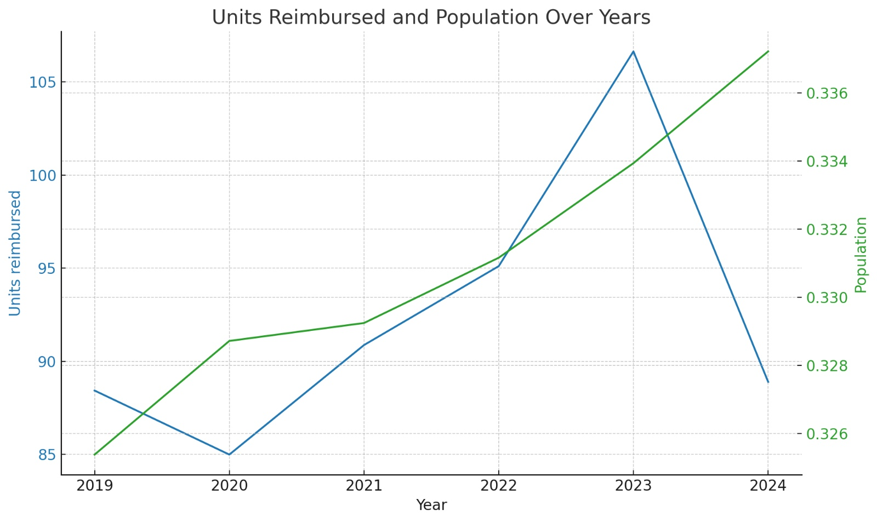
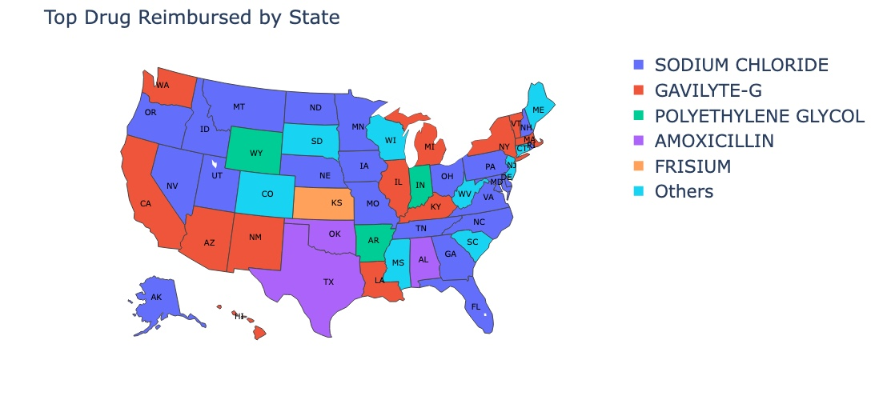
Exploratory Data Analysis
Population (Billion)
Units Reimbursed (Billion)
Units Reimbursed vs. Population over the years
Top Drug by Units Reimbursed (2024)
On average, as population increases, so does units reimbursed.
U.S. map showing top drug reimbursed in the U.S. is Sodium Chloride.
8
Notes:
Rajivini
This decline was primarily due to the expiration of the COVID-19 continuous coverage provision, which had previously prevented states from disenrolling individuals from Medicaid during the public health emergency. Once this provision ended in March 2023, states resumed eligibility redeterminations, leading to significant disenrollments throughout

Slide 9
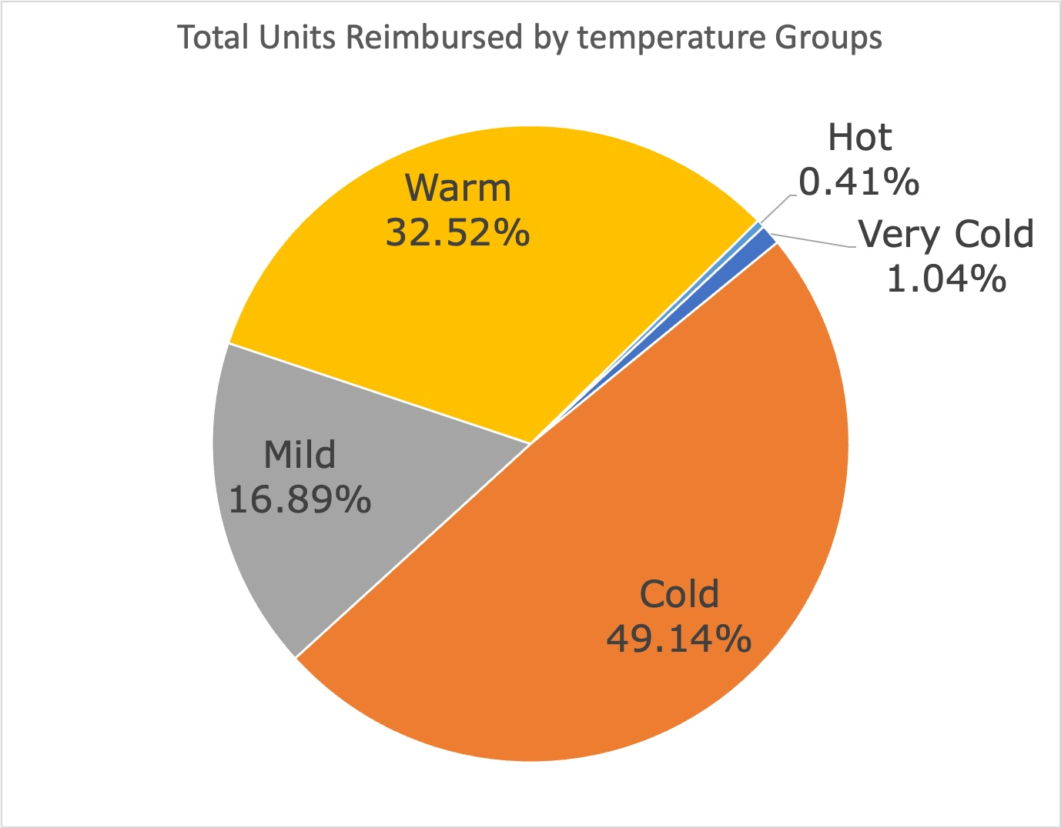
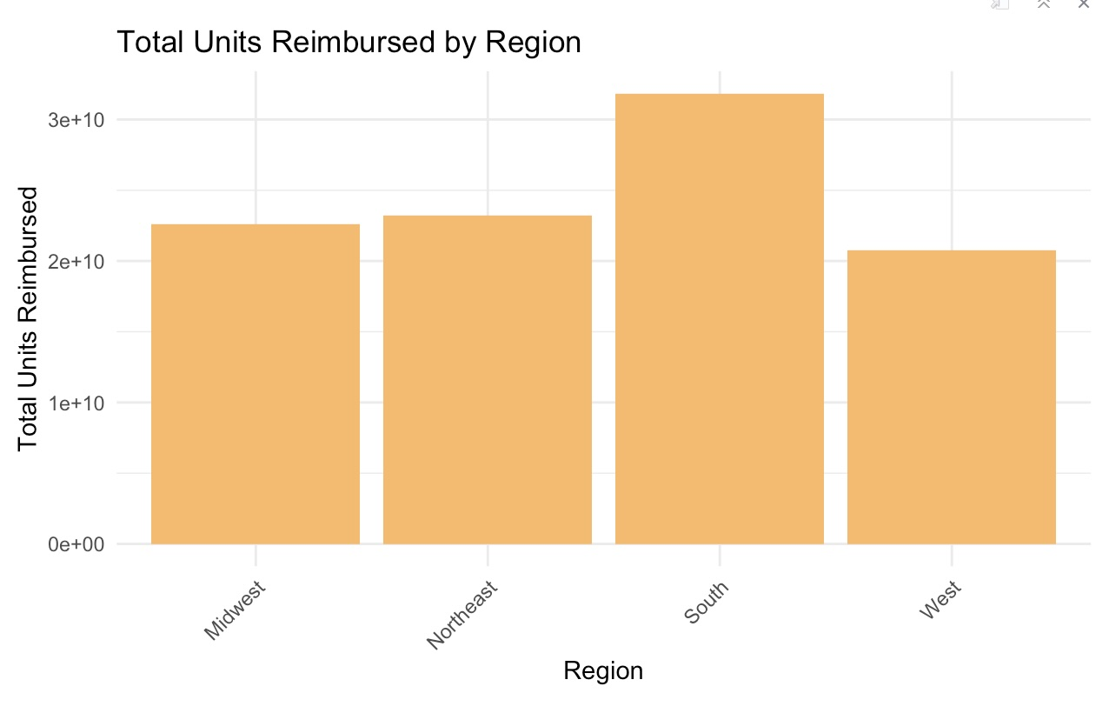
Exploratory Data Analysis
Units Reimbursed Across Different Temperature
Units Reimbursed by Region
As expected, cold weathers have the highest reimbursements.
Units reimbursed according to population, grouped by regions
9
Notes:
Rajivini

Slide 10
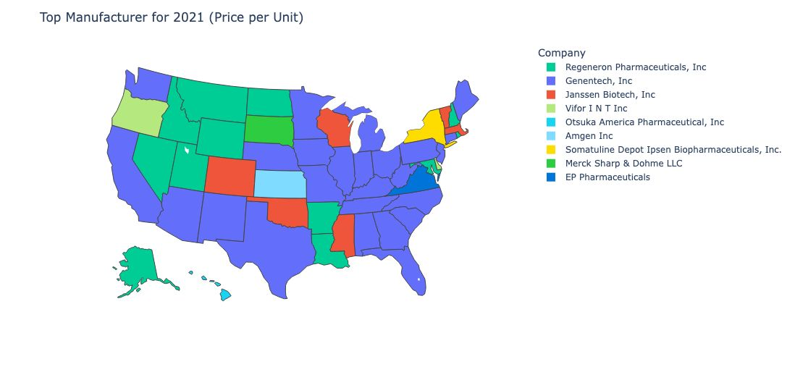
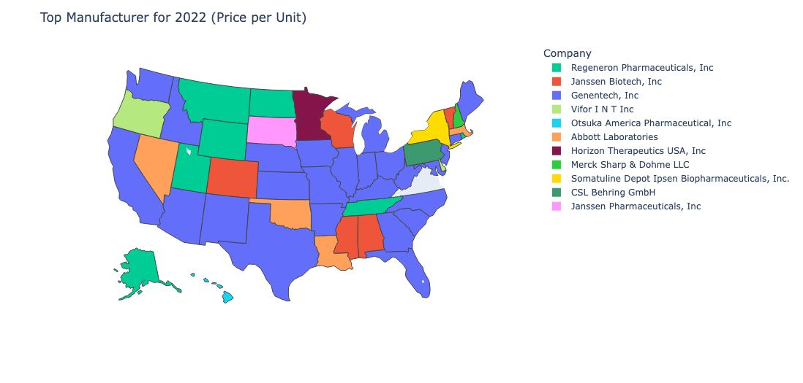
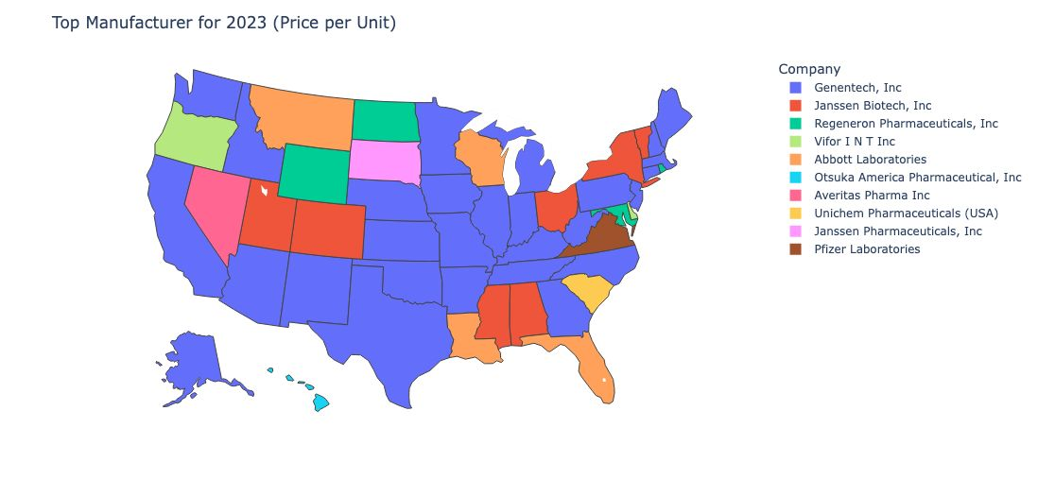
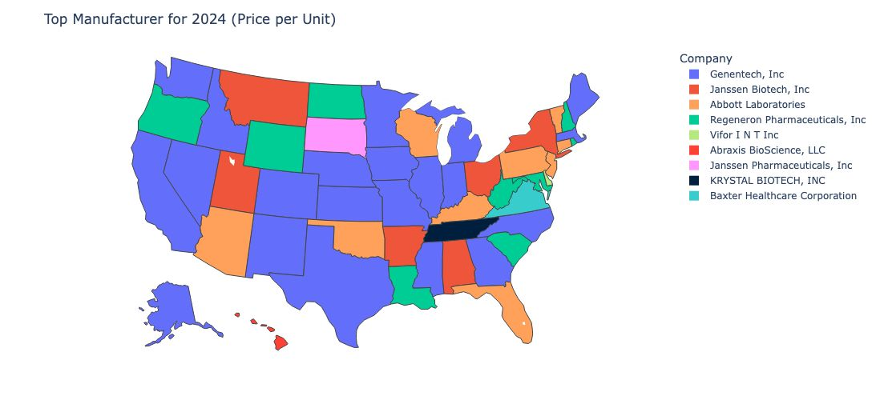
Top Manufacturer Trends (2021-2024)
10
Notes:
Rajivini
Why did TN change from merck to krystal biotech

Slide 11




Preprocessing for Model Creation
Combined Medicaid data with Socioeconomic data
ARIMA-Based Index Projection
Merged Medicaid drug utilization data with external metrics including Real GDP, average temperature, state poverty rates, population estimates and per capita income.
Applied ARIMA to forecast socioeconomic index trends to predict future trends
Target Encoding
Data Partitioning
Categorical variables were encoded using target mean encoding with 5-fold cross-validation, mapping category-wise training means onto validation folds.
80% Training Dataset
20% Test Dataset
11
Notes:
Prabhu

Slide 12
Model 1: Multiple Linear Regression
Variable | Coefficient
Temperature Index (Scaled) | 6653.0
Poverty Index (Scaled) | 7616.1
Medicaid Amount Reimbursed (Scaled) | 255289.5
Number of Prescriptions (Scaled) | 2963643.9
Variable | Coefficients
Personal Income (Scaled) | -1734.40
GDP per state (Scaled) | -12113.50
Non-Medicaid Amount Reimbursed (Scaled) | -64398.60
12
Notes:
Prabhu

Slide 13
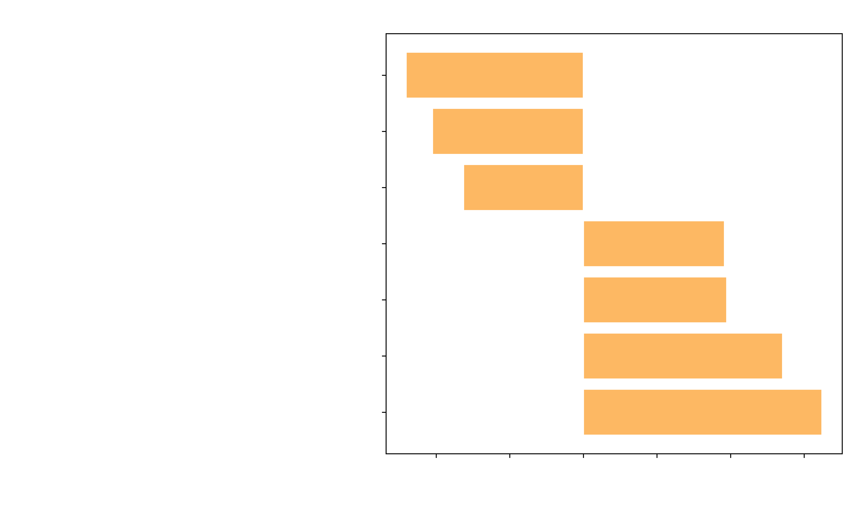
Model 1: Multiple Linear Regression
13
Notes:
Prabhu

Slide 14
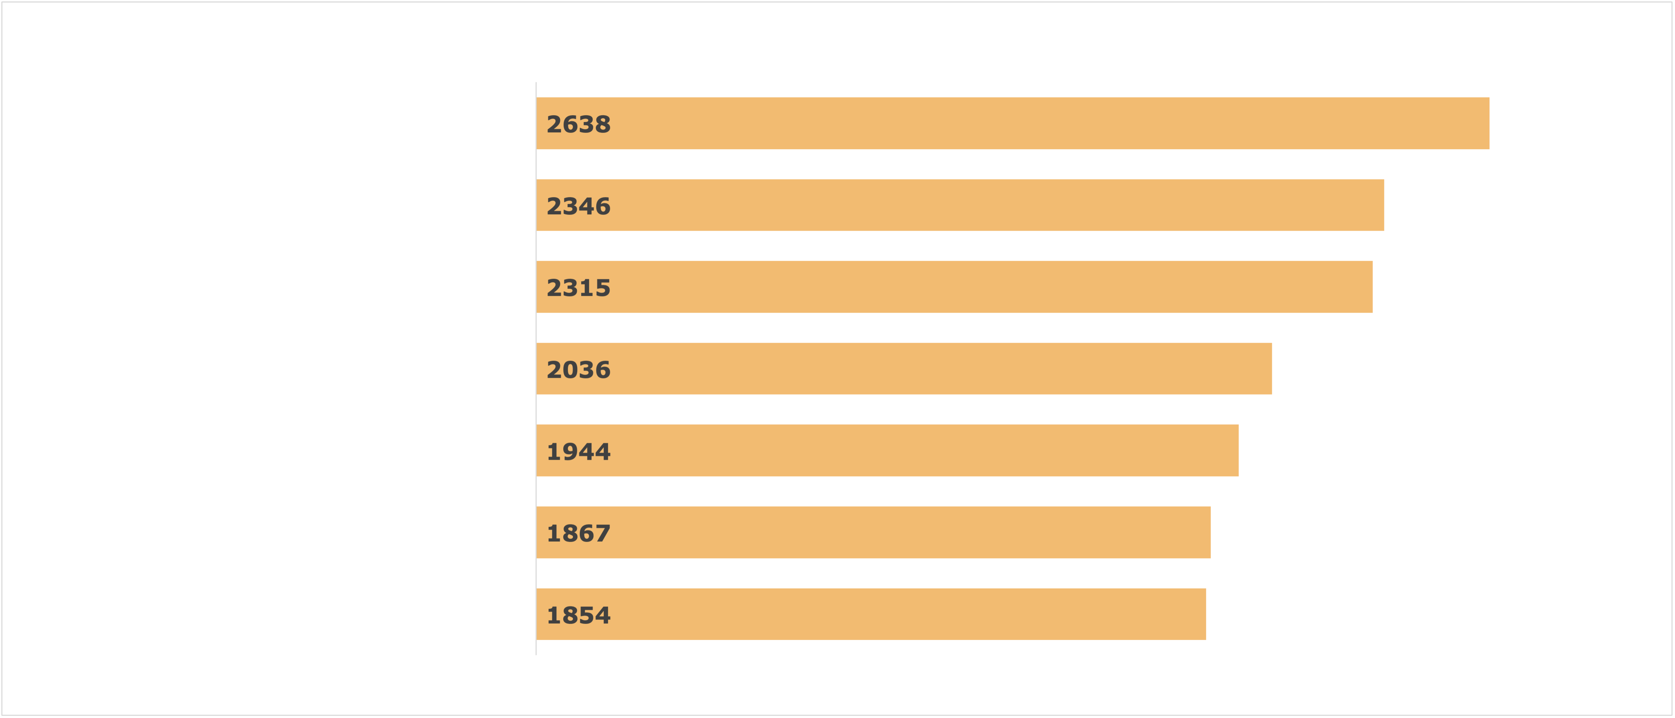
Model 2: Light GBM Method
14
Notes:
Prabhu

Slide 15
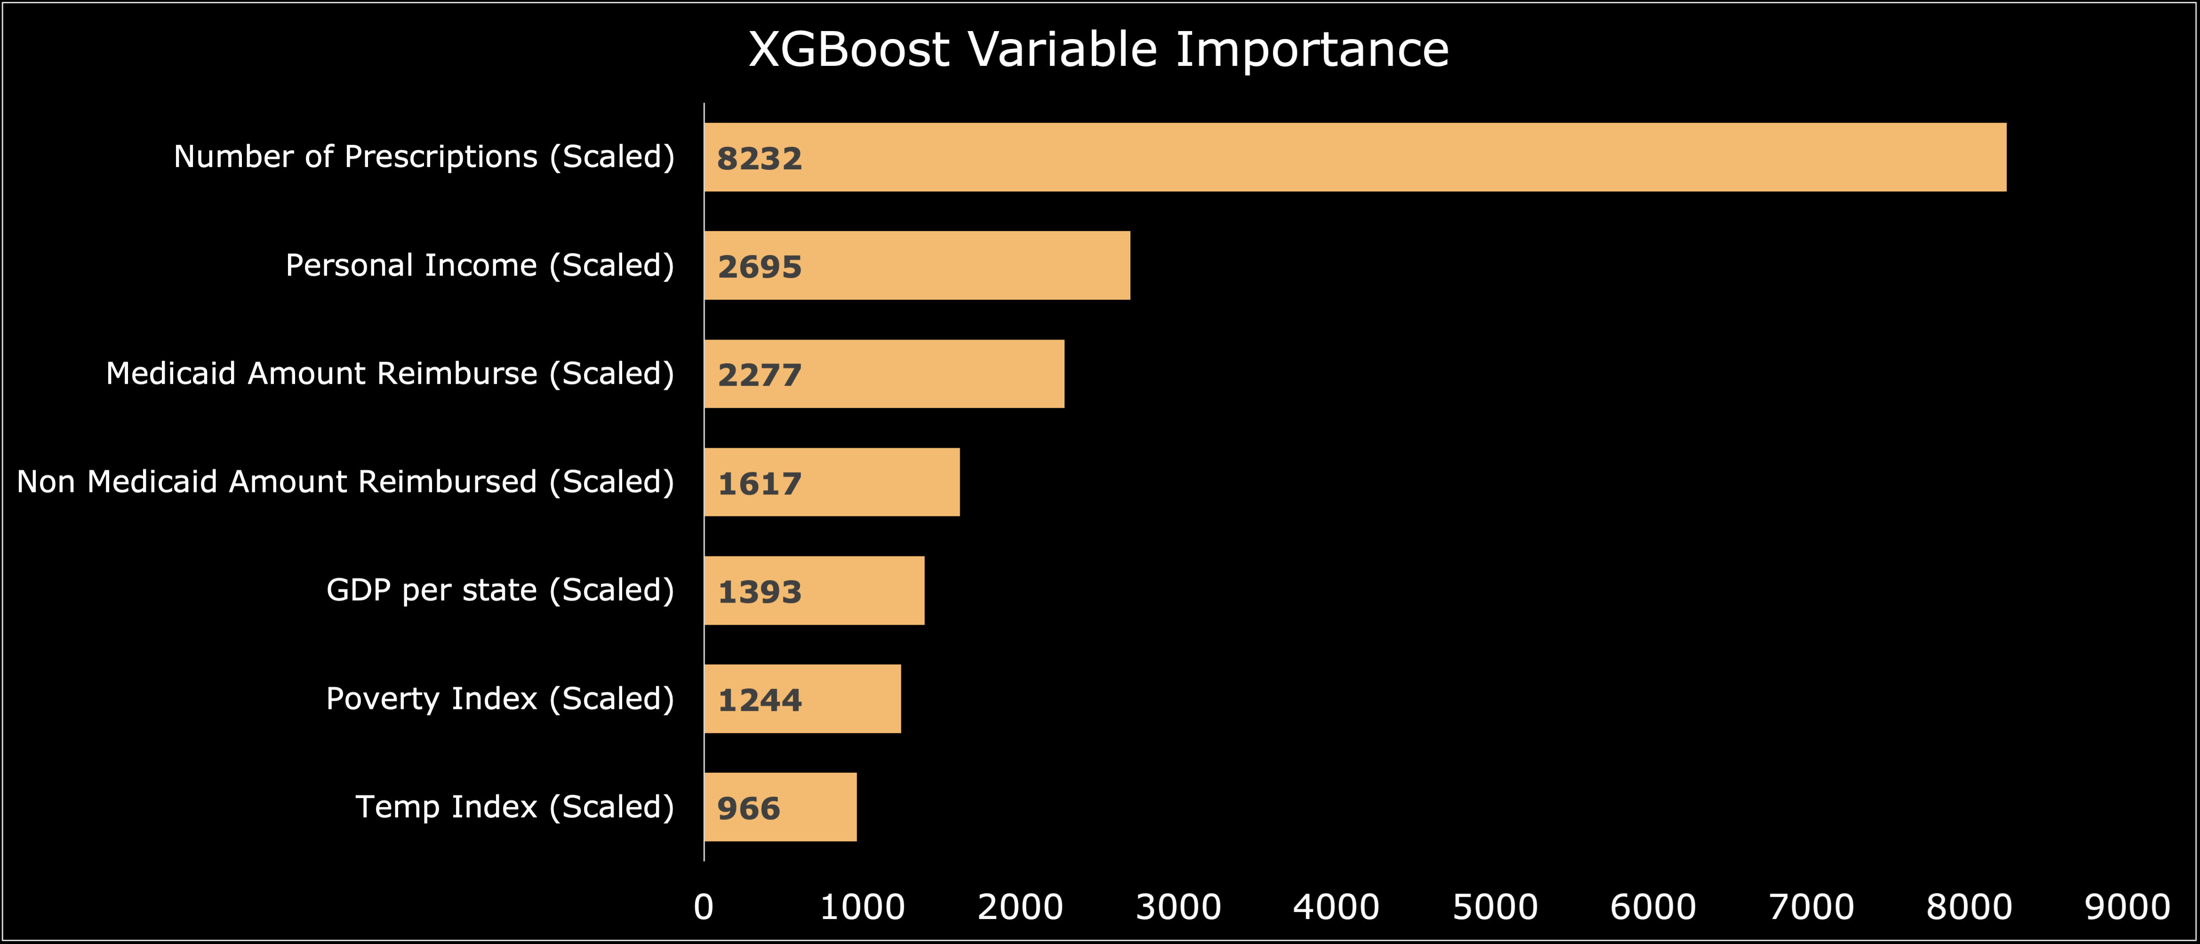
Model 3: XGBoost Method
15
Notes:
Prabhu

Slide 16
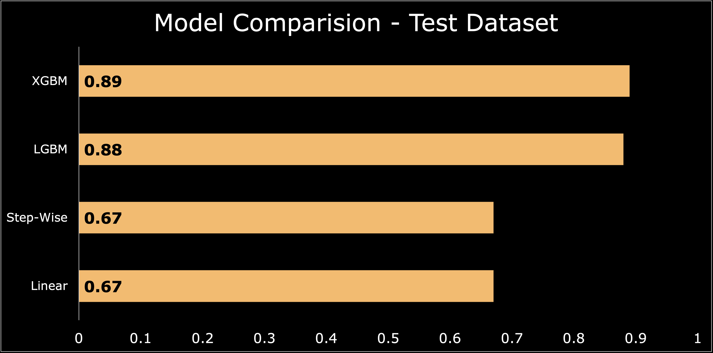
Predictive Performance Comparison (R²)
16
Notes:
Raheela

Slide 17
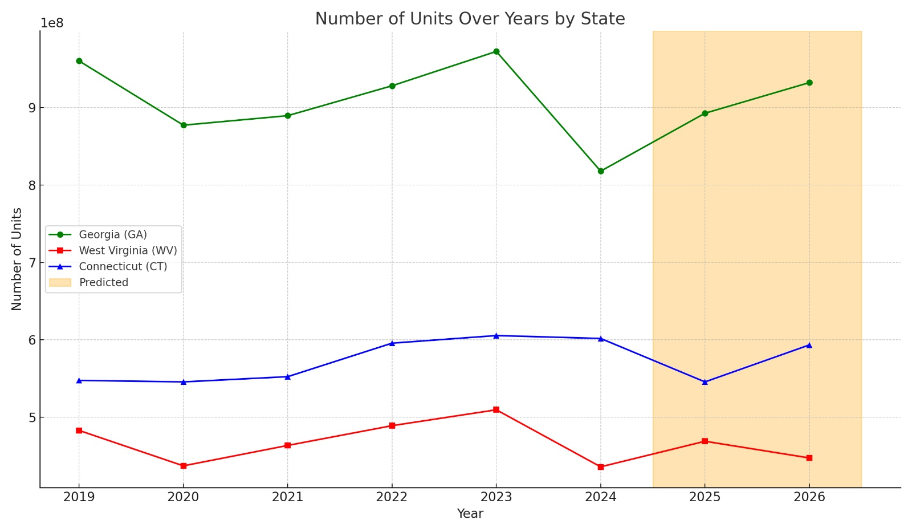
Predictions via XGBoost Model
Pandemic
17
Notes:
Raheela – we choose WV and CT to bc these have the have highest units reimbursed
March 18, 2020 – apr 1, 2023 The FFCRA was signed into law. It required states to keep people continuously enrolled in Medicaid in exchange for receiving more federal funding (an enhanced FMAP—Federal Medical Assistance Percentage).
Medicaid enrollment surged — between February 2020 and March 2023, over 20 million new enrollees joined Medicaid nationally

Slide 18
Cost-Benefit Analysis of Predictive Modelling
Item | Value
Baseline error cost (8% RMSE) | $274,424,620
Model error cost (1% RMSE) | $34,303,080
Variance Reduced | $240,121,540
Estimated realized savings (10%) | $24,012,154
Model improvements reduced error variance by $240M, enabling an estimated $24M in realized savings.
18
Notes:
Prabhu

Slide 19



Key Findings
Medicaid reimbursement driven by prescription volume
Consistency in reimbursed drug types across states
Inverse Link: Income vs. Reimbursements
Analysis shows the number of prescriptions and personal income are the most important variables.
The top reimbursed drugs, such as Sodium Chloride, are consistent across U.S. states (22).
States with higher Per capita Personal Income have lower reimbursements.
The analysis highlights the need to focus Medicaid forecasting and monitoring efforts on prescription volume trends and drug-specific patterns, rather than relying heavily on state-level economic factors.
19
Notes:
Prabhu

Slide 20


Recommendations
Focus predictive monitoring on prescription behavior as well as state economics
Analysis shows the number of prescriptions and amount reimbursed are highly significant whereas Temperature and poverty index are significant.
Prioritize volume patterns and drug-specific trends in future Medicaid forecasting models
Socioeconomic data offers limited incremental value for short-term forecasting
20
Notes:
Rajivini

Slide 21



Future Work
Add Drug Class Categories |  | Prescription Practices Not Captured |  | Explore Clustering by Policy vs. Geography
Explore grouping drugs by class (ex- painkillers, antibiotics) to uncover more nuanced trends. |  | Factors like hospital protocols that influence prescription behavior are not widely available. |  | Group states based on shared Medicaid policies to reveal policy-driven insights.
The analysis was constrained by data availability and scope, offering opportunities for future work to enhance the understanding of Medicaid reimbursement disparities.
21
Notes:
Raheela

Slide 22


Thank you! Questions?
Notes:
Raheela – Let’s put a bandaid on Medicaid!

Slide 23
Appendix Table of Contents
Slide # | Slide Description
2 | Background and Motivation
3 | Business Problem / Research Question
4 | Data Sources
5 | Dataset Description
6 | Data Cleaning
7 | EDA: Total amount reimbursed per 100K individuals (2019), Per Capita Personal Income (2019)
8 | EDA: Units Reimbursed vs. Population over the years, Top Drug by Units Reimbursed (2024)
9 | Units Reimbursed Across Different Temperature, Units Reimbursed by Region
10 | Top Manufacturer Trends (2021-2024)
11 | Preprocessing for Model Creation
12 | Model 1: Multiple Linear Regression (Coefficients)
13 | Model 1: Multiple Linear Regression (Log Scale Graph)
14 | Model 2: Light GBM Method
15 | Model 3: XGBoost Method
16 | Predictive Performance Comparison (R2)
17 | Predictions via XGBoost Model
18 | Cost-Benefit Analysis of Predictive Modelling
19 | Key Findings
20 | Recommendations
21 | Future Work
Notes:
Rajivini

Slide 24
Additional Macrovariables Data Dictionary
Name | Type | Description
Total_Amount_Reimbursed | Numeric | Total amount paid
Medicaid_Amount_Reimbursed | Numeric | Paid by Medicaid
State_GDP | Numeric | State-level Real GDP
Poverty_Index | Numeric | Percentage of population below poverty line
Temperature_Index | Numeric | Average annual temperature per state
Per_Capita_Income | Numeric | Average income per person in the state
Population_Estimates | Numeric | Total population of the state
Notes:
Rajivini

Slide 25
Medicaid Dataset Description
Name | Type | Description
utilization_type | string | Fee-For-Service Utilization & Managed Care Organization Utilization
state | string | State Name
ndc | string | LabelerCode + ProductCode + PackageSize
labeler_code | string | Name of Manufacturer/ Supplier
product_code | string | Manufacturer, labeler, packager or distributor of the Drug
package_size | string | Size of the Package of the Drug
year | integer | Year of Dataset
quarter | integer | Quarter of Dataset
product_name | string | Name of Product
units_reimbursed | number | Units of Drug Reimbursed
number_of_prescriptions | integer | Number of Prescriptions Reimbursed
total_amount_reimbursed | number | Total Amount Reimbursed
medicaid_amount_reimbursed | number | Medicaid Amount Reimbursed
non_medicaid_amount_reimbursed | number | Non-Medicaid Amount Reimbursed
*Medicaid Drug Utilization Dataset (CMS), 2019-2024
Notes:
Rajivini

Slide 26
Model 1: Multiple Linear Regression Results
Variable | Estimate | Std. Error | t value | p-value
(Intercept) | 3217 | 808 | 4 | 6.89E-05
Personal Income (Scaled) | -1734 | 1206 | -1 | 0.15
GDP per state (Scaled) | -12114 | 855 | -14 | < 2e-16
Poverty Index (Scaled) | 7617 | 1250 | 6 | 1.12E-09
Temp Index (Scaled) | 6653 | 862 | 8 | 1.15E-14
Non-Medicaid Amt Reimbursed (Scaled) | -64399 | 2751 | -23 | < 2e-16
Medicaid Amt Reimbursed (Scaled) | 255290 | 1799 | 142 | < 2e-16
Number of Prescriptions (Scaled) | 2963644 | 4013 | 739 | < 2e-16
Units Reimbursed = 13836 − 17925×Personal Income(Scaled) − 16587×GDP per State(Scaled) + 8453×Poverty Index(Scaled) + 15508×Temp Index(Scaled) + 80725×Non-Medicaid Amount Reimbursed(Scaled) + 3142535xNumber of Prescriptions(Scaled)
Notes:
Rajivini

Slide 27
Model 1: Multiple Linear Regression Results
Variable | VIF Value
GDP per State (Scaled) | 1.210120
Poverty Index (Scaled) | 2.523569
Temperature Index (Scaled) | 1.366394
NonMedicaid Amount Reimbursed (Scaled) | 1.008370
Number of Prescriptions (Scaled) | 1.016373
Personal Income (Scaled) | 2.541849
Metric | Value
Multiple R-squared | 0.6856
Adjusted R-squared | 0.6856
F-statistic | 1.11e+05
F-statistic p-value | <2.2e-16
Test Set R-squared | 0.6737
Units Reimbursed = 13836 − 17925×Personal Income(Scaled) − 16587×GDP per State(Scaled) + 8453×Poverty Index(Scaled) + 15508×Temp Index(Scaled) + 80725×Non-Medicaid Amount Reimbursed(Scaled) + 3142535xNumber of Prescriptions(Scaled)
Notes:
Rajivini

Slide 28
Predictive Performance Comparison
Model | R² Train | R² Test
Linear (Full) Model | 0.6856 | 0.6739
Linear (Stepwise) Model | 0.6856 | 0.6739
Light Gradient Boost Model | 0.8932 | 0.88
eXtreme Gradient Boost Model | 0.9345 | 0.8932
Notes:
Rajivini

Slide 29
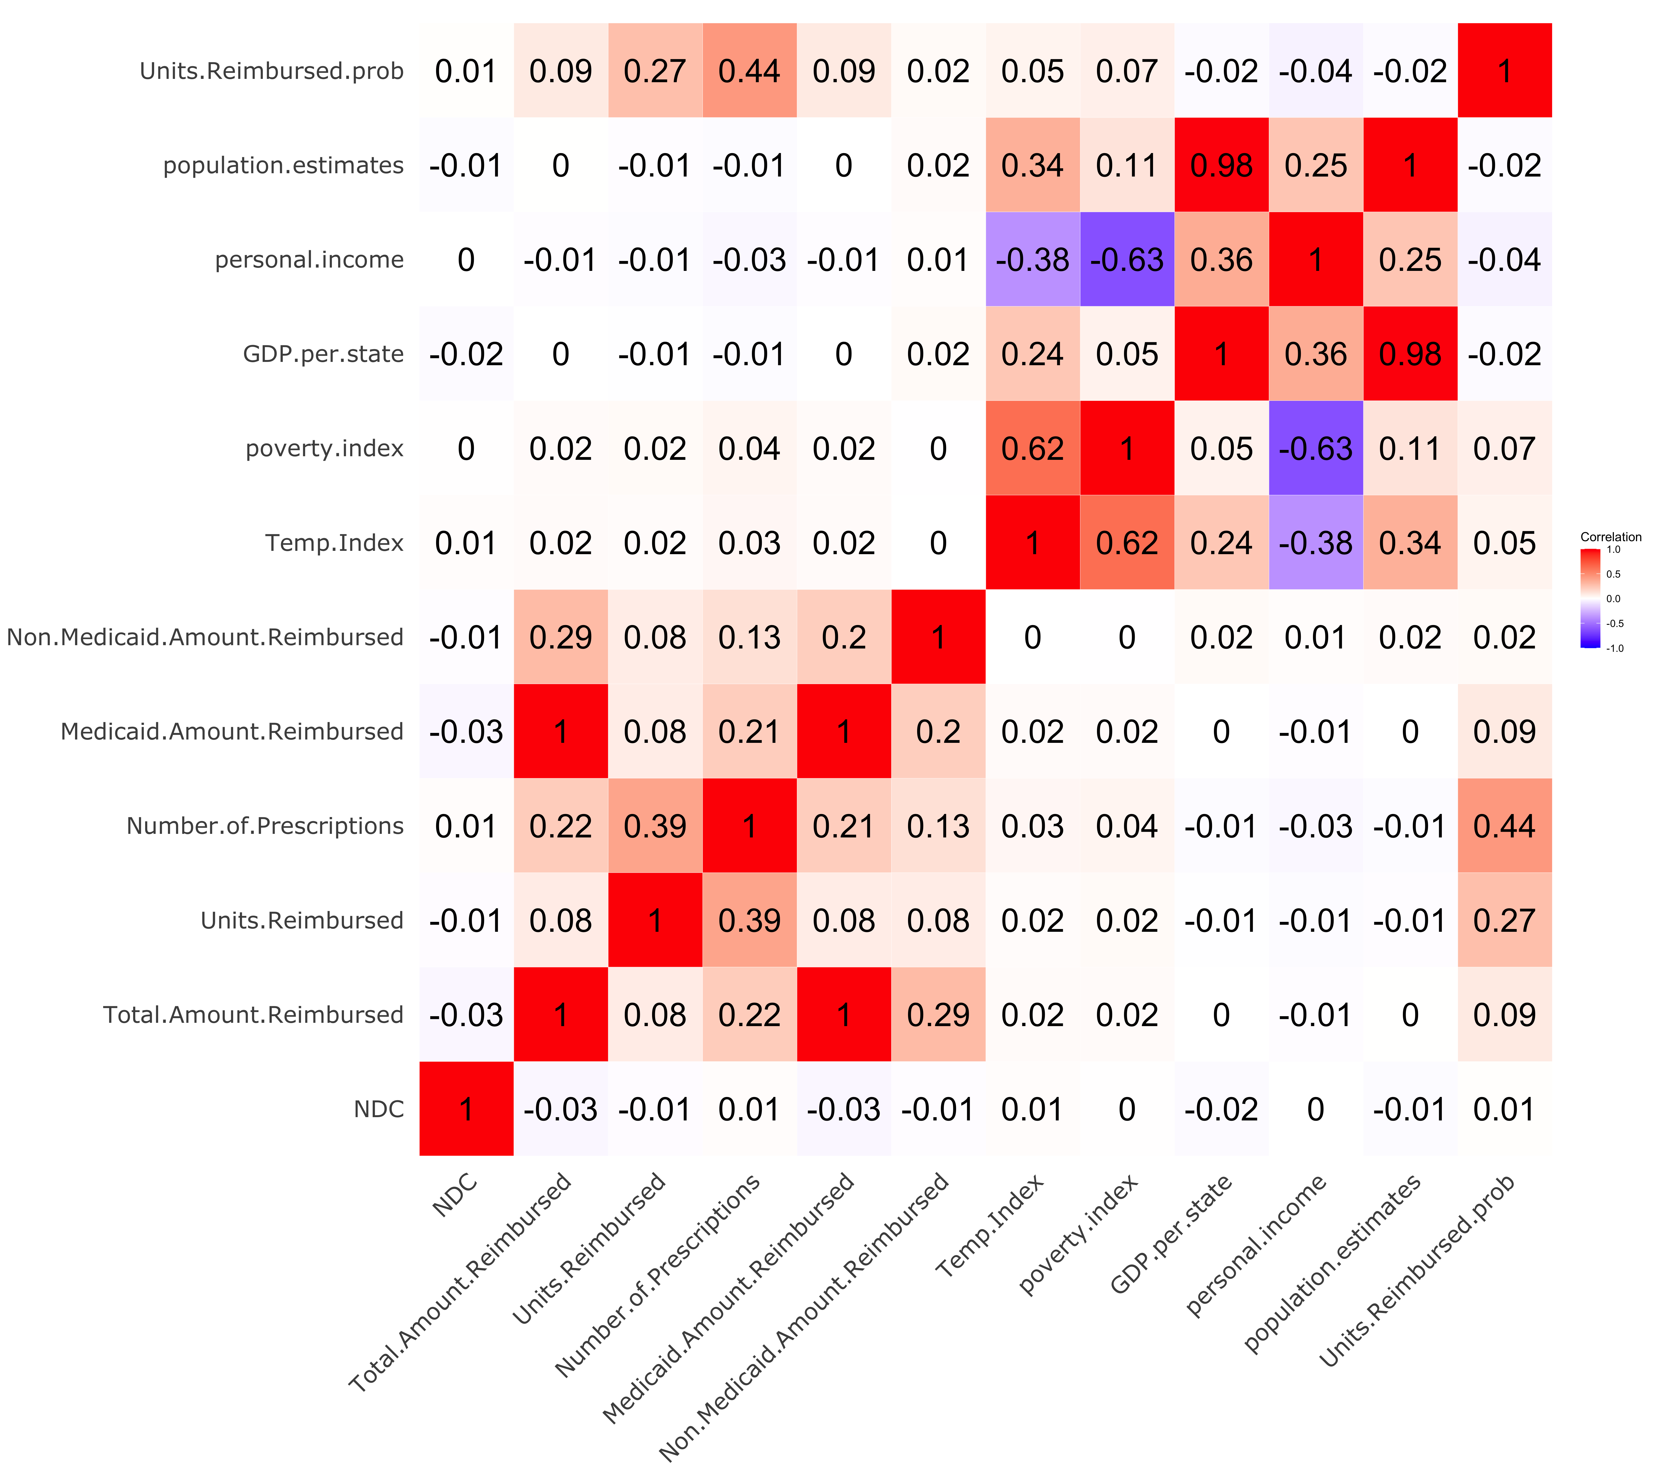
Correlation Matrix
Notes:
Raheela

